Slide 1

Why I’m Your Ideal Data Engineer: Unlocking Data’s Full Potential
Chandra Patel
Passionate about transforming complex data
Into actionable insights that drive business growth and innovation.
Proven expertise in building scalable data pipelines
Optimising ETL workflows, and ensuring impeccable data quality and integrity.
Deep understanding of your company’s data ecosystem
And how to strategically accelerate its analytics capabilities for competitive advantage.
Ready to bring innovative solutions
Leveraging cutting-edge tools and fostering a collaborative, results-oriented mindset.

Slide 2



My Data Engineering Impact: Real Results, Real Value
Cloud Migration
Move data lake to cloud
Pipeline Automation
Automated ETL with Airflow
Dashboard Creation
Interactive analytics dashboards
Cost Savings
Reduced processing costs 40%
Data Lake Architecture
Automated ETL Pipelines
Designed and deployed a data lake that reduced processing time by 40% at my previous company, enhancing efficiency and speed.
Implemented Apache Airflow and Spark to automate ETL, significantly improving data freshness and reliability for critical operations.
Enhanced Decision-Making
Cloud Migration & Cost Savings
Collaborated with data scientists and analysts to deliver insightful dashboards, increasing decision-making speed by 30%.
Led successful migration from on-premise to AWS/GCP, cutting infrastructure costs by 25% while boosting scalability.

Slide 3
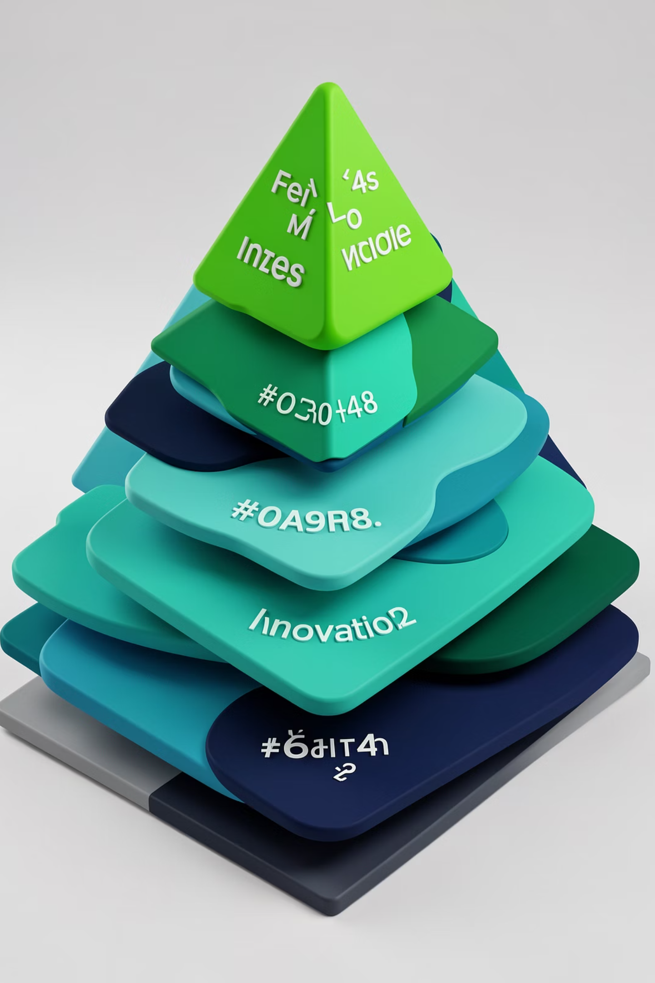




How I Will Elevate Your Team & Data Strategy
Strategic Alignment
Align data infrastructure with your strategic goals to unlock new analytics opportunities.
Robust Governance
Implement robust data governance and monitoring to ensure accuracy, security, and compliance across all data assets.
Collaborative Solutions
Foster cross-team collaboration to effectively translate complex business needs into scalable and efficient data solutions.
Continuous Innovation
Continuously innovate with emerging technologies like real-time streaming, data mesh, and advanced analytics.

Slide 4

Thank You!
Let’s Build the Future of Data Together
I am genuinely excited about the opportunity to contribute my skills and passion to your esteemed team at [Company Name].
I eagerly look forward to discussing how my experience can help accelerate your data-driven success and achieve your ambitious goals.

